Slide 1


We are kept from our goal, not by obstacles, but by a clear path to a lesser goal…

Slide 2





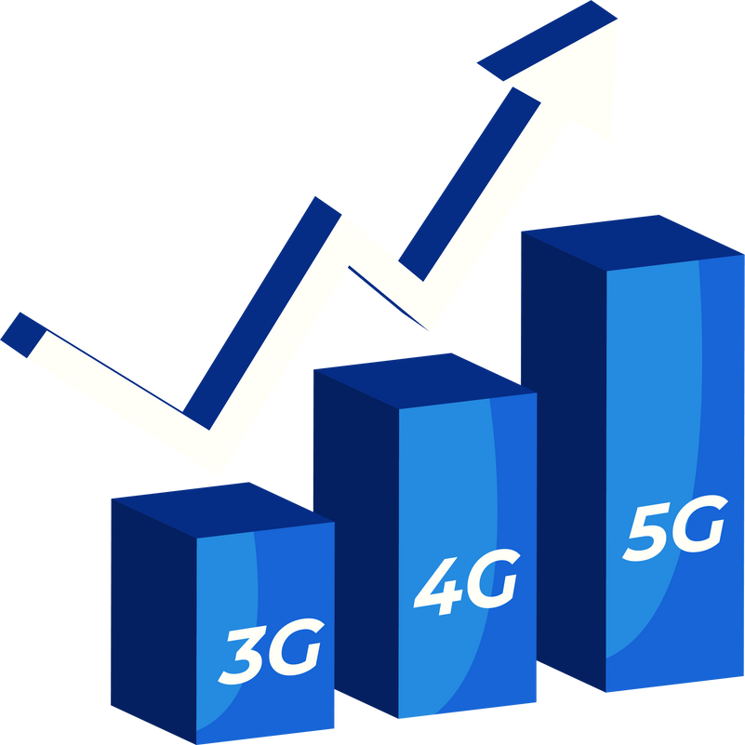


Integrated Program in Business Analytics
Telco Customer Churn
IPBA_B17: Group_F
Mentor : Mr. Ashish Mishra

Slide 3
Participants:
Mr. Dillip Meher
Ms. Dipanwita Das CHAKRABARTY
Ms. Sweta Dixit
Mr. Shobhit sharan
Mr. Sudhanshu Mittal
Ms. Suchismita Dash
Mr. Gaurav Maheshwari

Slide 4
Model: Churn.. Turn… Fun….

Slide 5



Agenda
Business Problem and Objectives
Executive Summary
Data Overview and Key Business Assumptions (if any)
Data Preparation and Pre-processing
Sanity checks, treatment and transformations
for analytical dataset preparation
Exploratory Data Analysis
Key Business Findings and Insights
Model Development and Validations
Model comparisons on key scoring metrics and model finalization
Dashboarding (required only when it is in scope of analysis)
Businesss Recommendations and Potential Business Impact
Next Steps
Appendix
© 2021 Jigsaw Academy Education Pvt Ltd.

Slide 6



Business problem
The Telecom company competition is Challenging, with lots of choices for customers. Because of this, the phone companies have a hard time keeping their customers, with about 15-20% leaving each year. This is a big problem because it costs a lot more money to get new customers than to keep the ones they already have.
Key Objectives
1 Identifying why customers Leaves
2 Measuring the Customer loss
3 Predicting Customer Action
4 Creating Customer Loyalty Programs
5 Effective Communication with Customers
6 Team Work Across Departments
© 2021 Jigsaw Academy Education Pvt Ltd.

Slide 7
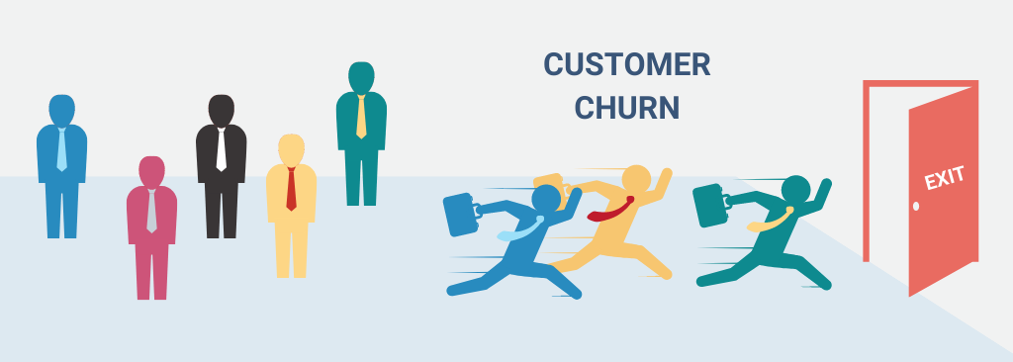
Executive Summary
"Customer churn, when customers leave a company, is a big problem for Telecom companies, happening about 15-20% each year. To tackle this, we need to understand why customers leave. We're using a special set of data to figure out why customers leave phone companies and try to predict when it might happen. Our goal is to make plans that will keep customers happy and working together as a team to keep them with us
© 2021 Jigsaw Academy Education Pvt Ltd.

Slide 8

Data Understanding/Data Dictionary
Classification Label :-
Churn — Whether the customer churned or not (Yes or No)
Service type:-
Internet Service — A type of internet service the customer has (DSL, Fiber Optic, No)
Online Security — Whether the customer has online security or not (Yes, No, No Internet Service)
Online Backup — Whether the customer has online backup or not (Yes, No, No Internet Service)
Device Protection — Whether the customer has device protection or not (Yes, No, No Internet Service)
Tech Support — Whether the customer has tech support or not (Yes, No, No Internet Service)
Streaming TV—Whether the customer has a streaming TV (Yes, No, No Internet Service)
Streaming Movies — Whether the customer has a streaming movie (Yes, No, No Internet Service)
Phone Service: Whether the customer has a phone service or not (Yes, No
Customer Demographic Iinformation:-
CustomerID — Unique value for each customer
gender — The type of gender each customer (Female, Male)
SeniorCitizen — Whether the customer is a senior citizen (Yes, No)
Partner — Whether the customer has a partner or not (Yes, No)
Dependents — Whether the customer has a dependent or not (Yes, No)
© 2021 Jigsaw Academy Education Pvt Ltd.

Slide 9
Data Understanding/Data Dictionary
Customer Account Information
Tenure — How long customer has stayed in the company
Contract — The type of contract the customer has (Month-to-Month, One year, Two years)
PaperlessBilling — Whether the customer has a paperless billing (Yes, No)
PaymentMethod — payment method used by the customer (Electronic check, Mailed check, Bank transfer (automatic), Credit card (automatic))
MonthlyCharges — Amount charged to the customer monthly
TotalCharges — The total amount charged to the customer
© 2021 Jigsaw Academy Education Pvt Ltd.

Slide 10
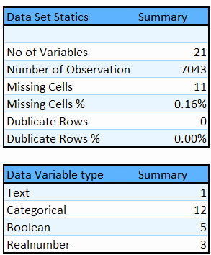

Data Overview
Telco customer Data set
SOURCE : KAGGLE
https://www.kaggle.com/datasets/blastchar/telco-customer-churn
© 2021 Jigsaw Academy Education Pvt Ltd.

Slide 11

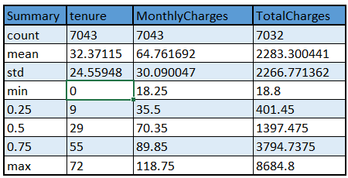
Data Overview
Summary Statics
75% customers have tenure less than 55 months
Average Monthly charges are USD 64.76 whereas 25% customers pay more than USD 89.85 per month
© 2021 Jigsaw Academy Education Pvt Ltd.

Slide 12
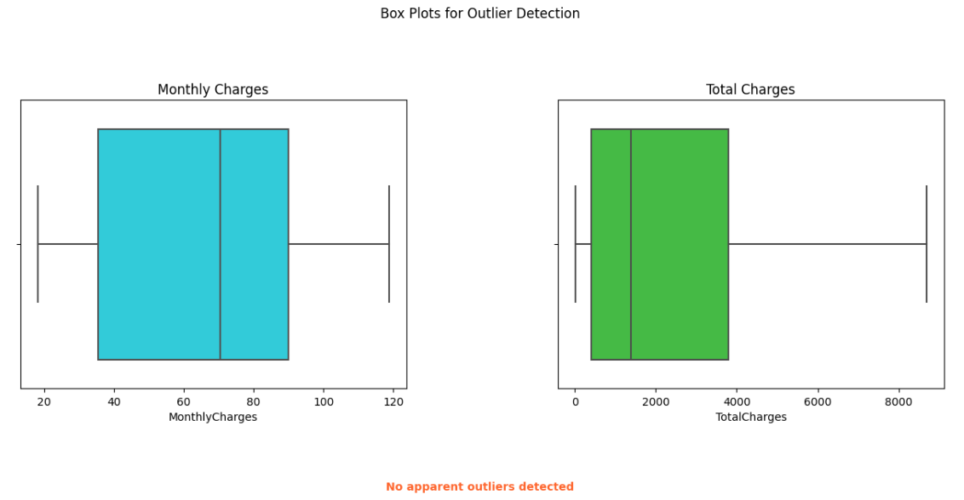
Data Overview
Outlier detection and treatment
There is no Outlier detected in Monthly charges as well as Total charges
© 2021 Jigsaw Academy Education Pvt Ltd.

Slide 13
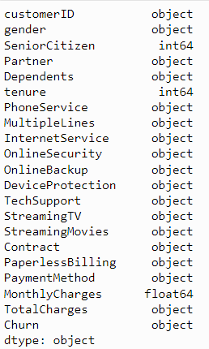
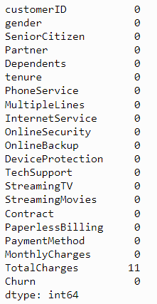
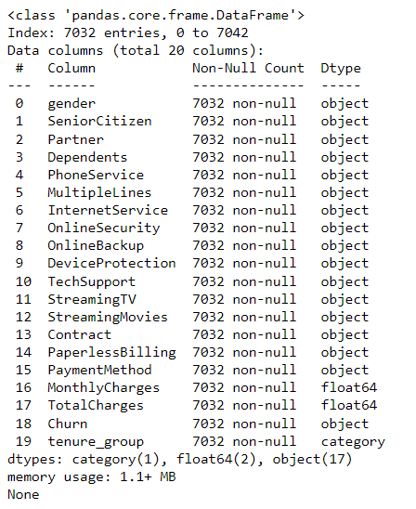
Data Overview Before Treatment
Data Overview After Treatment
DATA TYPE
Missing value
© 2021 Jigsaw Academy Education Pvt Ltd.

Slide 14
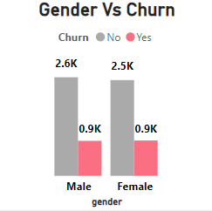
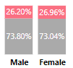
Exploratory Data Analysis (EDA) - Univariate
Customer Demographic- Gender
Finding :-
The percentage of churned and active customers is almost equal for both genders.
Approximately 26% of male customers and 27% of female customers churned.
Gender has little impact on customer churn
Insight :Gender of Customer does not play a significant role in predicting the Churn Rate. Additional Factors Should be consider for more compresive analysis of Churn Analysis.
© 2021 Jigsaw Academy Education Pvt Ltd.

Slide 15
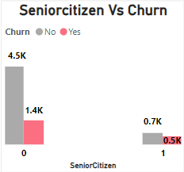
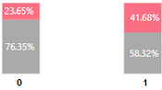
Exploratory Data Analysis (EDA) - Univariate
Customer Demographic- Seniorcitizen
Finding :-
Senior Citizens:
Churn rate: 41.7%
This group experiences a relatively higher churn rate as compare to other age group.
Non-Senior Citizens:
Churn rate: 23.7%
Non-Senior citizens exhibit a significantly lesser churn rate
Insight :Most of the senior citizens are under a monthly service plan, which could be due to financial reasons
© 2021 Jigsaw Academy Education Pvt Ltd.

Slide 16
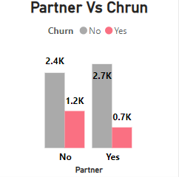
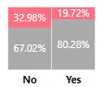
Exploratory Data Analysis (EDA) - Univariate
Customer Demographic- Partner
Finding :-
Found 20% Churn rate in customer with partner and 33% churn rate in Customer with outpartner.
Customer without Partner are churning more as compare to the customer with Partner
Insight :Customers with partners may exhibit different patterns of usage, loyalty, and satisfaction compared to those without partners.
© 2021 Jigsaw Academy Education Pvt Ltd.

Slide 17
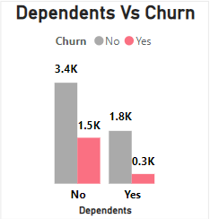
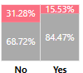
Exploratory Data Analysis (EDA) - Univariate
Customer Demographic- Dependents
Finding :-
Found 31% Churn rate in customer with out Dependents and 15.5% churn rate in Customer with Dependent
Customers without dependents are churning more compared to customers with dependents.
Insight :Customers with dependents may have different usage patterns, preferences, and loyalty compared to those without dependents as well as Customer without dependents having their own source of income have they are prone to churn
© 2021 Jigsaw Academy Education Pvt Ltd.

Slide 18
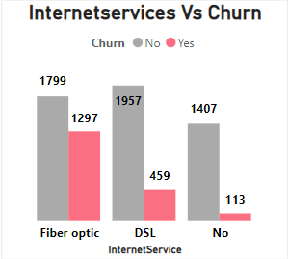
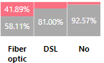
Exploratory Data Analysis (EDA) - Univariate
Customer Service Type- Internetservices
Finding :-
Customers with fiber optic internet service have the highest churn rate, at 41.9%.
DSL (Digital Subscriber Line) customers experience a churn rate of 19%.
Customers who do not have internet service face a lower churn rate of 7.4%
Insight : Fiber Optic
Speed Expectation: Eventhough Fiber Optic promises blazing fast speeds,but if the actual performance falls short, customers may become dissatisfied and switch providers.
Installation Challenges :Installing fiber optic infrastructure can be complex and time-consuming. Delays or issues during installation can frustrate customers.
Price Sensitivity: Fiber optic tends to be more expensive. If customers perceive that the cost outweighs the benefits, they might churn.
DSL:- Digital Subscriber line may be outdated , Slow speed and Frequent disruption and inadecuate technical support for DSL
© 2021 Jigsaw Academy Education Pvt Ltd.

Slide 19
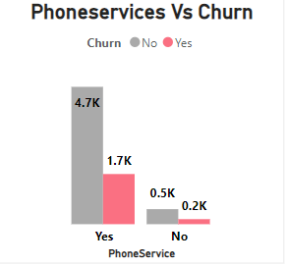
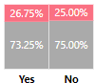
Exploratory Data Analysis (EDA) - Univariate
Customer Service Type- Phoneservices
Finding :-
The churn rate for customers with phone services is 26.7% as well as The churn rate for customers without phone services is 25%.
Customers without phone service exhibit a substantially lower churn rate
Insight :
The presence or absence of Phone Service alone may not be a strong predictor of customer churn.The presence or absence of Phone Service is a noteworthy predictor of customer churn.
© 2021 Jigsaw Academy Education Pvt Ltd.

Slide 20
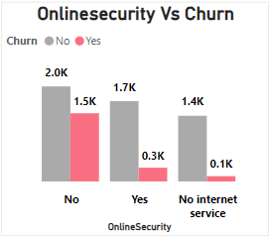
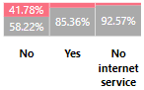
Exploratory Data Analysis (EDA) - Univariate
Customer Service Type- Onlinesecurity
Online security services typically include features like antivirus protection, firewall, and secure browsing aim to safeguard customers’ data, privacy, and online activities
Finding :-
Customers with No onliesecurity have the hichurn rate, at 42%.
The absence of Onlinesecurity sevices associated with high churnrate
Insight : Most of these customers which don’t have Onlinesecurity service fall under the Monthly contract type which is flexible of exit as well as not dependent .
© 2021 Jigsaw Academy Education Pvt Ltd.

Slide 21
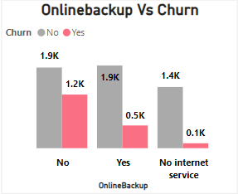
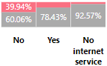
Exploratory Data Analysis (EDA) - Univariate
Customer Service Type- Onlinebackup
Finding :-
Customers with No onlinebackup have the hichurn rate, at 40%. The absence of onlinebackup services asssociated with higher churn rate
Insight : The telecommunications company should consider promoting the benefits of online backup to customers as part of a strategy to potentially reduce churn rates.
© 2021 Jigsaw Academy Education Pvt Ltd.

Slide 22
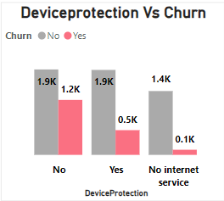
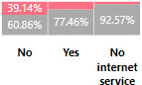
Exploratory Data Analysis (EDA) - Univariate
Customer Service Type- Deviceprotection
Finding :-
Customers with No device protection have the hichurn rate, at 39%. the absence of Device Protection is associated with higher customer churn.
Insight : It's important for the telecommunications company to consider strategies to encourage customers to opt for device protection services to potentially reduce churn rates.
© 2021 Jigsaw Academy Education Pvt Ltd.

Slide 23
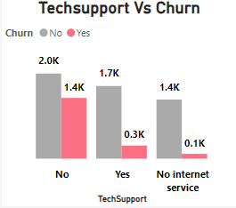
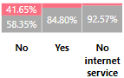
Exploratory Data Analysis (EDA) - Univariate
Customer Service Type- Techsupport
Finding :-
Customers with No Techsupport have the hichurn rate, at 41.6%. the absence of Technicalsupport is associated with higher customer churn.
Insight : The telecommunications company should explore strategies to enhance tech support offerings to potentially reduce churn rates.
© 2021 Jigsaw Academy Education Pvt Ltd.

Slide 24
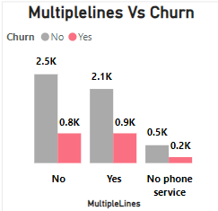
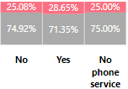
Exploratory Data Analysis (EDA) - Univariate
Customer Service Type- Multiplelines
Finding :-
Customers with Single lines have the churn rate, at 25%. Customers with multiple lines have churn rates at 28.6% and No phone services have 25% churn rate.
Insight : Customers with multiple lines might not varying churn rates so much compared to those with a single line. Further analysis is needed to determine the impact.
© 2021 Jigsaw Academy Education Pvt Ltd.

Slide 25
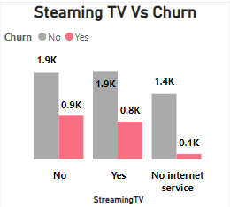
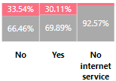
Exploratory Data Analysis (EDA) - Univariate
Customer Service Type- Steaming TV
Finding :-
Customer having Steaming tv subscription and with out subscription having alomst similar churn rate 30% & 33.5% respectively.
Insight : the availability of Streaming TV services alone may not significantly influence customer churn. Further analysis considering additional factors is recommended to better understand the predictors of customer churn in the context of streaming TV services.
© 2021 Jigsaw Academy Education Pvt Ltd.

Slide 26
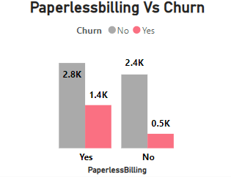
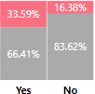
Exploratory Data Analysis (EDA) - Univariate
Account information- Paperlessbilling
Finding :-
Customer having paperless billing having the churn rate at 33.6% . Customers who use Paperless Billing are churning more in comparison to their counterparts .
Insight :
Paperless billing are lack of pesonal touch, billing transperancy issue, digital fatigue and preference of simplicity. Customer with paperless billing target as autopayment which lead to more chrun.
© 2021 Jigsaw Academy Education Pvt Ltd.

Slide 27
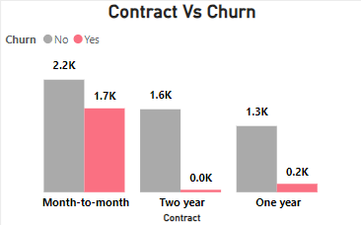

Exploratory Data Analysis (EDA) - Univariate
Account information- Contract
Finding :-
Customers with different contract types exhibit varying churn rates. Month to Month contract having higest Churn rate . There is 43% Churn rate in Month to Month Contract
Insight : Because Month to month contrat have high monthly charges as compare to one year and two year contract. As month to month contract has more flexi so it is more prone to churn
© 2021 Jigsaw Academy Education Pvt Ltd.

Slide 28
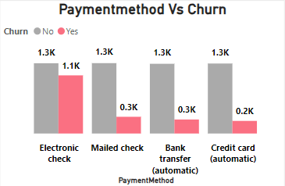
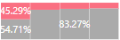
Exploratory Data Analysis (EDA) - Univariate
Account information- Payment Method
Finding :-
Customers with Electronic check payment method have high churn rate at 45% as compare to other payment method.
Insight : Electronic check openness to alternative providers. Here Customer has the control on the payment method 100% and make the payment as per their feasible time. Telecome company should encourage to chage the payment method to credit card or Bank tranfer automatic.
© 2021 Jigsaw Academy Education Pvt Ltd.

Slide 29
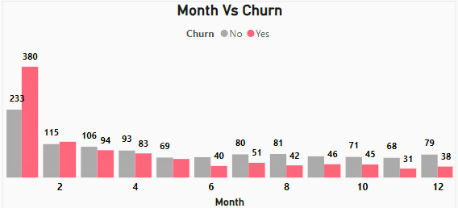
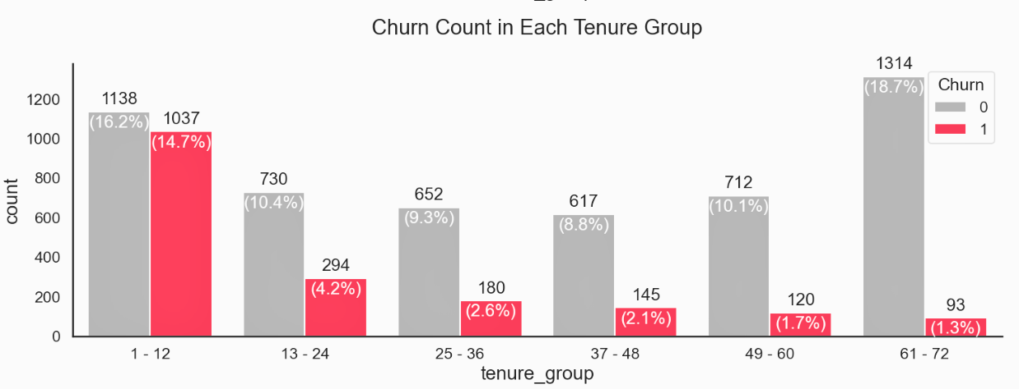
Exploratory Data Analysis (EDA)
if we would look at the One year of Tenure by Making by fracting monthy then we are able to see 1st Month have more churn followed by 2nd, 3rd and 4th Month
Tenure groups of 1-12 and 13–24 are churning more which can be intuitively understood from the fact that teens and early 20s customers are changing their telecom services more frequently and thus are not so loyal customers
Insight : New Customer : -Customers who have recently joined the telecom service are more prone to churn. Perhaps they encountered issues or found a better deal elsewhere
Long-Term Loyal Customers: On the other hand, customers with longer tenure tend to stay. Their loyalty could be attributed to positive experiences, trust, or inertia like reliable Service, Excellent Cutomer support, Transparent Billing, Customized offer, Community engagement and consisency network upgrade
© 2021 Jigsaw Academy Education Pvt Ltd.

Slide 30
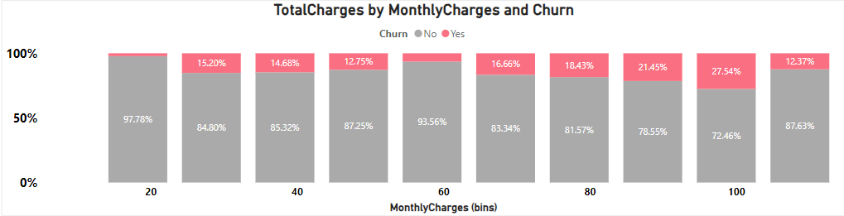
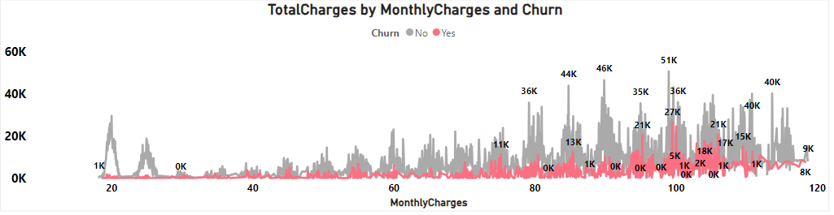
Bivariate Analysis -EDA
Monthly Charges and Total Charges Relationship:
Higher monthly charges often lead to shorter tenure as customers may find the cost unsustainable. Consequently, their total charges are lower due to the shorter duration. This combination of high monthly fees and short tenure contributes to a higher churn rate.
© 2021 Jigsaw Academy Education Pvt Ltd.

Slide 31
Exploratory Data Analysis (EDA)
Derived Insight
Monthly Charges: Customers with higher monthly charges may be more sensitive to price changes or service quality. If they perceive the value isn’t worth the cost, they might switch.
Total Charges: Higher total charges may correlate with increased churn. Customers who consistently pay more may be more likely to switch providers or seek better deals elsewhere.
Tenure :-
New Customer : -Customers who have recently joined the telecom service are more prone to churn. Perhaps they encountered issues or found a better deal elsewhere
Long-Term Loyal Customers: On the other hand, customers with longer tenure tend to stay. Their loyalty could be attributed to positive experiences, trust, or inertia like reliable Service, Excellent Cutomer support, Transparent Billing, Customized offer, Community engagement and consisency network upgrade
Factor like Gender and Mulitple line have no impact on the Churn rate
© 2021 Jigsaw Academy Education Pvt Ltd.

Slide 32
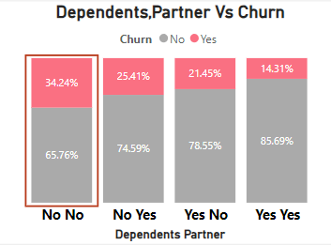
Bivaritate Analys -EDA
Finding :-
The absence of dependents and partners seems to be associated with higher churn rates
Insight :
Lack of Emotional Support :
Individuals without dependents or partners may lack emotional support networks. When faced with service issues or dissatisfaction, they might not have someone to discuss it with or seek advice. As a result, they may be more likely to switch providers without hesitation
Financial Constraints & Life changes : Single individuals often manage their finances independently as well as customer without dependents or partners might experience significant life changes (e.g., job relocation, lifestyle shifts, personal growth) more frequently
© 2021 Jigsaw Academy Education Pvt Ltd.

Slide 33
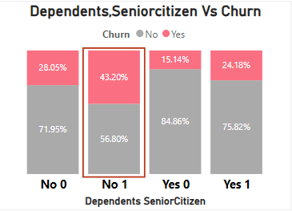
Bivaritate Analys -EDA
Finding :-
Customer who is no dependents and Seniorcitizen seems to be associated with higher churn rates
Insight :
customer without dependent have the grate financial indepndance more like to switch the provider if they find better offer and seniorcitizen often experience changeing need related to technology and communication and services . if the current provider doesn’t meet these evolve needs , may switch
© 2021 Jigsaw Academy Education Pvt Ltd.

Slide 34
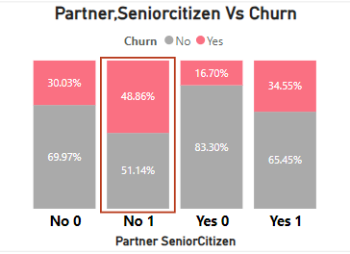
Bivaritate Analys -EDA
Finding :-
Customer who is no Parner and Seniorcitizen seems to be associated with higher churn rates
Insight :
senourcitizen no parner mean less immediate support during health emergencies.Loneliness and lack of social support may lead to a higher likelihood of churn .
© 2021 Jigsaw Academy Education Pvt Ltd.

Slide 35
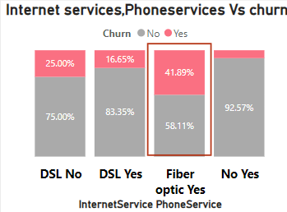
Bivaritate Analys -EDA
Finding :-
Customer who is having Fiber optics internet services as well as have phone services seems to be associated with higher churn rates
Insight :
Investigating potential service quality issues with fiber optic connections, including frequent outages and slow speeds. Assessing the competitiveness of fiber optic plans in terms of pricing. Evaluating the quality of customer support for fiber optic users.
Analyzing specific features of phone services such as call clarity and pricing to identify reasons for telco customer churn.
I
© 2021 Jigsaw Academy Education Pvt Ltd.

Slide 36
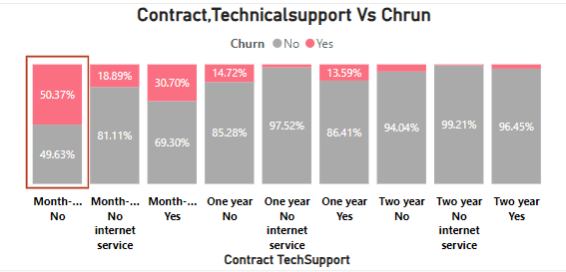
Bivaritate Analys -EDA
Finding :-
Customer who is having Fiber optics internet services as well as have phone services seems to be associated with higher churn rates
Insight :-
Month-to-month contracts often lead to higher churn rates due to their lack of long-term commitment, susceptibility to pricing changes, and potential dissatisfaction with service; additionally, customers without access to tech support are more likely to churn due to unresolved technical issues, communication challenges, and the allure of competitor offers with better support options.
© 2021 Jigsaw Academy Education Pvt Ltd.

Slide 37
Features Pre-Processing
Raw data can be transformed into features that are suitable for machine learning models that process called feature engineering. The aim of feature engineering is to make a machine learning model for better learning and get more accuracy. In this article, we will label encoding for categorical variables that have two values, one hot encoding for categorical variables that have more than two values, and feature calling for numerical variables.
Label Encoding
Label encoding aims to convert categorical variables to numerical format. In this article, we will change categorical variables that have two values such as (Partner, Dependents, PhoneService, Churn, PaperlessBilling). Values of them just have Yes or No and we will change to 1 and 0 except gender is Female to 1 and Male to 0.
One Hot Encoding
Same with label encoding, one hot encoding also changes categorical variables to numerical variables. But, one hot encoding takes more than two values. One hot encoding creates a new binary integer (1 or 0) column for each level of the categorical variable. Categorical variables that have more than two values are (MultipleLines, InternetService, OnlineSecurity, OnlineBackup, DeviceProtection, TechSupport, StreamingTV, StreamingMovies, Contract, PaymentMethod).
© 2021 Jigsaw Academy Education Pvt Ltd.

Slide 38
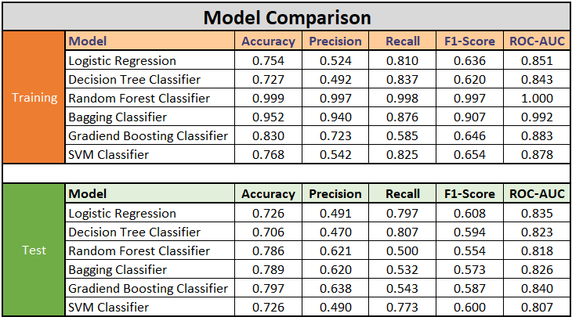
Train Test Split
Train test split is a process to validate the data set and simulate how the model performs with new data. In this article, we create 80% of train data and 20% of testing data. The “Churn” column we rename (the “y”) and the features column we rename (the “X”).
© 2021 Jigsaw Academy Education Pvt Ltd.

Slide 39
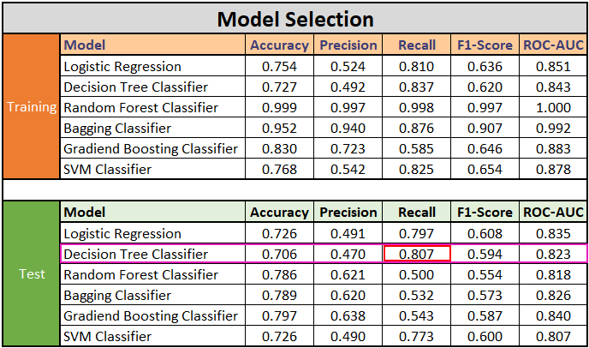

Model Selected
© 2021 Jigsaw Academy Education Pvt Ltd.

Slide 40
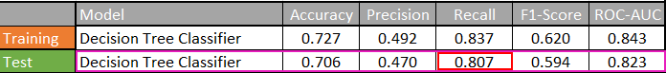
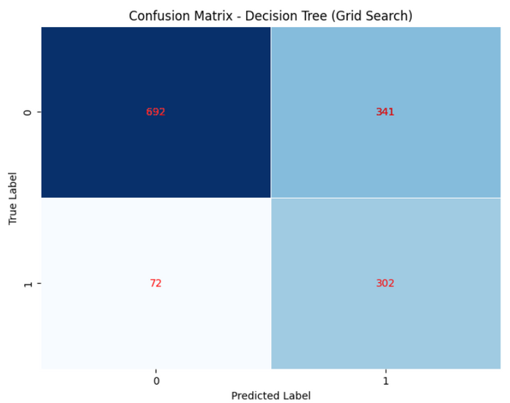


Descision tree Model Selection
Model Selected
we have chosen the Decision Tree Classifier due to its high recall (0.807) in handling imbalanced data . The number of Non Churn customer (Negative class) significantly outweight the number of churn Customer (Positive Class) . The goal as to correctly identify as many churned customers as possible while minimizing false negatives (FN) – cases where actual churns are misclassified as non-churns.
The Decision Tree model excels in minimizing false negatives (FN), which is crucial for identifying potential churns
True Positives (TP): 302
True Negatives (TN): 692
False Positives (FP): 341
False Negatives (FN): 72
Recall (Sensitivity): Proportion of actual churned customers correctly identified.
Recall : TP/(TP+FN) = 0.807
72
Precision:Proportion of true positive predictions among all positive predictions
Precision :(TP/TP+FP) = 0.470
Accuracy:Overall correctness of predictions.
Accuracy :(TP+TN)/(TP+TN+FP+FN) = 0.706
F1-Score: Harmonic mean of precision and recall
F1 Score : 2 X PrecisionXRecall / Precision + Recall = 0.594
© 2021 Jigsaw Academy Education Pvt Ltd.

Slide 41
Descision Tree Model - Balancing the FP & FN
Trade-Off: Precision vs. Recall:
Precision: Measures how many of the predicted positive cases are actually true positives (TP). It focuses on minimizing false positives (FP).
Recall (Sensitivity): Measures how many of the actual positive cases (churns) are correctly identified. It focuses on minimizing false negatives (FN).
TN
FP
72
FN
TP
Why Minimizing FN Matters:
In churn prediction:
False Positives (FP): Predicting a customer will churn when they won’t. This may lead to unnecessary retention efforts or costs.
False Negatives (FN): Failing to predict a churn when it actually occurs. This can result in losing valuable customers.
Business Impact:
FNs are costlier: Missing a churned customer means losing potential revenue and the opportunity to retain them.
FPs can be managed: Overestimating churn can be addressed through targeted retention efforts.
True Positives (TP): 302
True Negatives (TN): 692
False Positives (FP): 341
False Negatives (FN): 72
© 2021 Jigsaw Academy Education Pvt Ltd.

Slide 42

ROC Curve for Descision Tree
The ROC curve is a graphical representation of a model’s performance across different thresholds for classification problems.It plots the True Positive Rate (TPR) against the False Positive Rate (FPR) as the threshold varies
The TPR (also known as recall or sensitivity) represents the proportion of actual positive cases correctly predicted by the model.
The FPR represents the proportion of actual negative cases incorrectly predicted as positive.
The ROC curve helps visualize the trade-off between sensitivity and specificity (1 - FPR).
Higher AUC values indicate better discrimination power of the model in distinguishing between positive and negative cases.
AUC is particularly useful when dealing with imbalanced datasets (e.g., more non-churned customers than churned ones).
AUC: Area under the ROC curve
© 2021 Jigsaw Academy Education Pvt Ltd.

Slide 43

Importat Feature Selection for Descision Tree
1.Contract Type (Month-to-Month): The type of contract significantly impacts churn. Customers with month-to-month contracts are more likely to churn. This feature has the highest importance at 65.8%
2.Internet Service (Fiber Optic): Customers using fiber optic internet service are also more prone to churn. It contributes 10.5% to the model's decision.
3.Tenure: The length of time a customer has been with the telco affects churn. Longer tenure tends to reduce churn. This feature accounts for 10.1%of the model's prediction.
4.Monthly Charges: Higher monthly charges may lead to churn. This feature has a smaller impact at 4.1%.
5.Payment Method (Electronic Check): Customers using electronic checks for payment are more likely to churn. It contributes 2.4% to the model.
6.Tech Support (No): Lack of tech support increases churn. This feature has an impact of 1.96%.
7.Contract Type (Two-Year): Customers with two-year contracts end to stay longer, reducing churn. It contributes 1.5%
8. Total Charges: The total amount charged over time affects churn. It has a smaller impact at 1.2%.
9.Contract Type (One-Year) Customers with one-year contracts fall in between month-to-month and two-year contracts. It contributes 1.1%
© 2021 Jigsaw Academy Education Pvt Ltd.

Slide 44
Importat Feature - Descision Tree
Insights and Understanding:
Focus on Contract Type: The month-to-month contract is a critical factor. Consider offering incentives or discounts to encourage customers to switch to longer-term contracts.
Improve Fiber Optic Service: Address issues related to fiber optic internet service to retain those customers.
Enhance Tech Support: Providing better tech support can reduce churn.
Payment Methods: Encourage other payment methods besides electronic checks.
Customer Education: Educate customers about the benefits of longer-term contracts.
Note: these insights are based on the model's predictions, and real-world factors may vary.
© 2021 Jigsaw Academy Education Pvt Ltd.

Slide 45

© 2021 Jigsaw Academy Education Pvt Ltd.

Slide 46

Thank
you!
© 2021 Jigsaw Academy Education Pvt Ltd.

